Slide 1


PROJECT DESIGN REVIEW - TS 1
Hybrid Movie Recommendation System
Bridging the Gap Between Global Blockbusters and Regional Cinema
A scalable, big-data recommendation engine merging 32 Million global ratings with deep NLP metadata to solve industry-standard recommendation flaws.
What We Built
32M+ ratings processed at scale
Hollywood + Bollywood unified
Hybrid ML inference engine
VANSH GOEL – 24SCSE1720002
SHIVA TYAGI – 24SCSE1500002

Slide 2
PROBLEM STATEMENT
Core Challenges Addressed
Traditional recommendation systems suffer from three fundamental flaws that limit their real-world effectiveness and regional inclusivity.
❄️ The "Cold Start" Dilemma
🌐 Domain Isolation
⚡ Scalability Constraints
Existing systems are constrained to single datasets, ignoring regional cinema like Bollywood — an industry producing thousands of films annually.
Computing an 89,000 × 89,000 similarity matrix locally exceeds standard memory bounds — making naive approaches computationally infeasible.
Traditional Collaborative Filtering fails for new releases with zero user ratings — leaving fresh content invisible to audiences who would love it.
2
Vansh Goel & Shiva Tyagi

Slide 3
DATA ARCHITECTURE
Dataset and Methodology: The Architecture
🎬 MovieLens 32M
🗄️ TMDB & IMDb
The Golden Bridge
The behavioral foundation supplying 32 million user ratings — the largest publicly available movie rating dataset.
The metadata backbone for genres, plots, and cast — non-commercial APIs providing rich textual content for NLP processing.
Utilized the MovieLens links.csv file to perform horizontal DataFrame merges, generating synthetic IDs to append regional datasets vertically.
This bridge is what makes cross-domain recommendations possible — unifying Hollywood and Bollywood into a single coherent index.
Bollywood Dataset
Over 1,600 regional movies injected to expand the recommendation space beyond Hollywood.
3
Vansh Goel & Shiva Tyagi

Slide 4
DATA TRANSFORMATION
Dataset and Methodology: Feature Engineering
Transforming raw data into meaningful features is crucial for empowering our recommendation engine with contextual understanding and robust performance.
Feature Synthesis: Unified "Tags" Corpus
NLP Text Normalization
Handling Missing Values
Applied regular expressions to strip noise and utilized the NLTK Porter Stemmer to reduce vocabulary to core root forms for consistent feature processing.
Bypassed NaN (Not a Number) ratings from regional datasets by imputing a median 5.0 backend score, preventing matrix math failures during inference.
Combined movie 'overview', 'genres', 'cast', and 'director' fields into a single "Tags" corpus for enhanced contextual similarity in NLP processing.
4
Vansh Goel & Shiva Tyagi

Slide 5
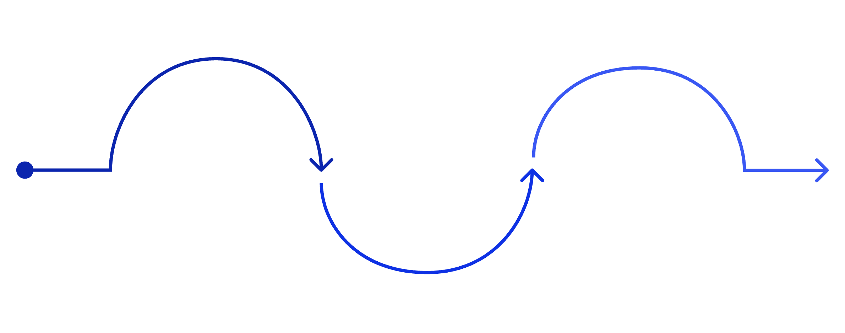
ML PIPELINE
Dataset and Methodology: ML Pipeline
Big Data Processing
Hybrid Inference
PySpark + ALS matrix factorization
Content NLP
Cosine similarity fused with IMDb ratings
TF‑IDF 5,000‑feature sparse matrix
1
2
3
Big Data Processing
Content-Based NLP
Hybrid Inference Formula
Utilized PySpark and an Alternating Least Squares (ALS) Matrix Factorization algorithm to predict user ratings at massive scale.
Deployed NLTK Porter Stemmer and TF-IDF Vectorization to transform text (genres, cast, plot) into a 5,000-feature sparse matrix.
Score = (Cosine Similarity × 0.8) + (Normalized IMDb Rating × 0.2) — weighting content relevance heavily while anchoring to quality signals.
5
Vansh Goel & Shiva Tyagi

Slide 6

SYSTEM ARCHITECTURE
Work Done So Far: System Architecture
Decoupled Architecture
🖥️ Web Interface
Separated PySpark batch-processing from the web inference engine to prevent Java Virtual Machine memory overhead — enabling lightweight, fast web responses.
Built a fully functional, responsive Streamlit application featuring:
Cinema design aesthetic
Dynamic outbound IMDb routing
Real-time recommendation rendering
On-the-Fly Mathematics
Loads optimized .npz sparse matrices and calculates cosine similarity on-demand in milliseconds — no pre-computation bottleneck.
6
Vansh Goel & Shiva Tyagi

Slide 7



RESILIENT UI
Work Done So Far: The Zero-API Engine
Engineering around real-world infrastructure constraints required creative, production-grade solutions at every layer of the stack.
Zero-API Poster Engine
Metahub Integration
Graceful Degradation
Bypassed restrictive ISP API blocking by engineering a custom poster-fetching pipeline — no external API keys required.
Formatted and injected IMDb IDs directly into HTML to utilize the Stremio Metahub Community CDN for secure, browser-side image fetching.
Implemented inline JavaScript onerror attributes to hot-swap broken images with locally encoded Base64 SVG placeholders instantly.
7
Vansh Goel & Shiva Tyagi

Slide 8


RESULTS
Preliminary Results & Model Performance
~0.8102
1,600+
RMSE Score
Bollywood Films
Highly competitive Root Mean Squared Error on the Collaborative Filtering model
Regional movies successfully normalized and integrated into the unified scoring system
✅ Cold Start Problem: Eliminated
The system can now accurately recommend movies with zero user ratings purely based on TF-IDF textual metadata matching — a core breakthrough of this project.
⚖️ Cross-Domain Normalization
Successfully standardized and normalized ratings across both Hollywood and Bollywood datasets, ensuring fair scoring visibility regardless of origin.
8
Vansh Goel & Shiva Tyagi

Slide 9
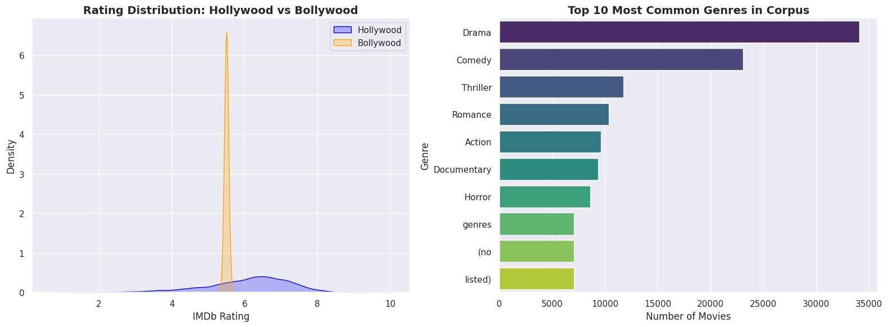
RESULTS
Preliminary Results – Visualization
9
Vansh Goel & Shiva Tyagi

Slide 10
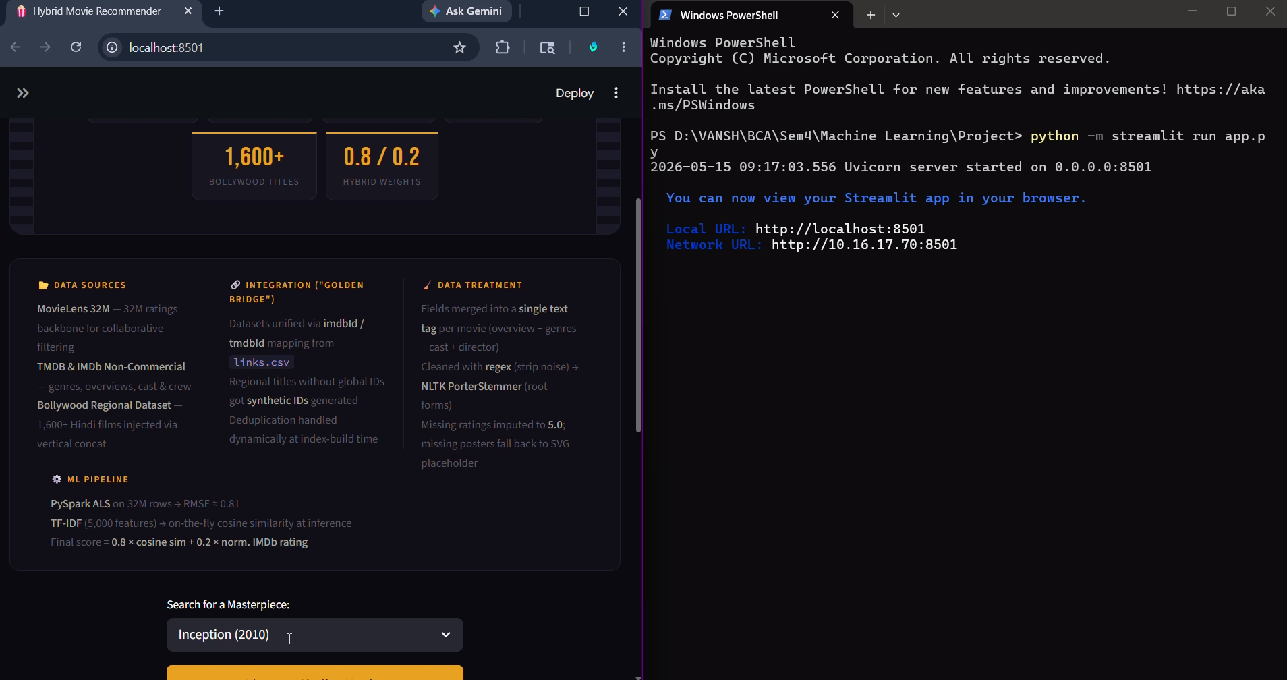
RESULTS
Preliminary Results – Steamlit UI
10
Vansh Goel & Shiva Tyagi

Slide 11
ENGINEERING CHALLENGES
Technical Challenges & Solutions
Matrix Memory Limits
Data Duplication
Missing Regional Ratings
Challenge: Pre-computing a 40GB dense similarity matrix was infeasible on standard hardware.
Challenge: Horizontal and vertical dataset merges introduced duplicate entries with conflicting metadata.
Challenge: Bollywood films lacked standardized user ratings, breaking the scoring formula.
Solution: Utilized SciPy sparse matrices and real-time inference — computing only what's needed, when it's needed.
Solution: Backend defaults to a median 5.0 score for math integrity; UI dynamically renders "Unrated" for full transparency.
Solution: Handled dynamically during index generation by dropping duplicates and retaining the highest-quality metadata versions.
11
Vansh Goel & Shiva Tyagi

Slide 12
ROADMAP
Next Steps & Long-Term Vision
Outlining the critical milestones for project completion and strategic future development.
Refine Streamlit UI
Integrate Bollywood Ratings
Long-Term Vision
Polish the user interface to ensure a seamless, intuitive, and production-ready experience for end-users, focusing on responsiveness and visual appeal.
Post-submission plans include transitioning to advanced Neural Collaborative Filtering (Deep Learning) models and achieving full cloud deployment on platforms like AWS or Heroku.
Incorporate a supplementary dataset of Bollywood film ratings to enrich the model, specifically to replace missing values and enhance regional scoring accuracy.
12
Vansh Goel & Shiva Tyagi

